Slide 1




DataVerse
Africa
Impact of Agricultural Credit on Farmer Productivity in Kenya
Internship Presentation
Presented By:
Rosemary Mtape

Slide 2


01
Problem Statement
Context
Kenya's agricultural sector relies heavily on smallholder farmers, who play a crucial role in food production and economic stability. Despite their importance, these farmers often face significant barriers in accessing affordable credit.
Issue
Limited access to credit prevents smallholder farmers from investing in essential agricultural inputs, such as quality seeds, fertilizers, and machinery. This lack of investment leads to suboptimal productivity and contributes to ongoing food insecurity.

Slide 3
Impact
Without adequate credit, the potential for increased agricultural output and improved farmer livelihoods is severely hindered. Addressing this gap is vital for enhancing food security, promoting economic growth, and empowering rural communities in Kenya.

Slide 4
02
Project Objectives
Primary Objective
To assess the impact of agricultural credit on the productivity and economic outcomes of smallholder farmers in Kenya.
Secondary Objective
Analyze the challenges smallholder farmers face in accessing and utilizing agricultural credit.
Provide evidence-based recommendations for improving agricultural credit programs to maximize their effectiveness.
Offer data-driven recommendations for stakeholders, including governments and financial institutions, to create more effective agricultural policies.

Slide 5

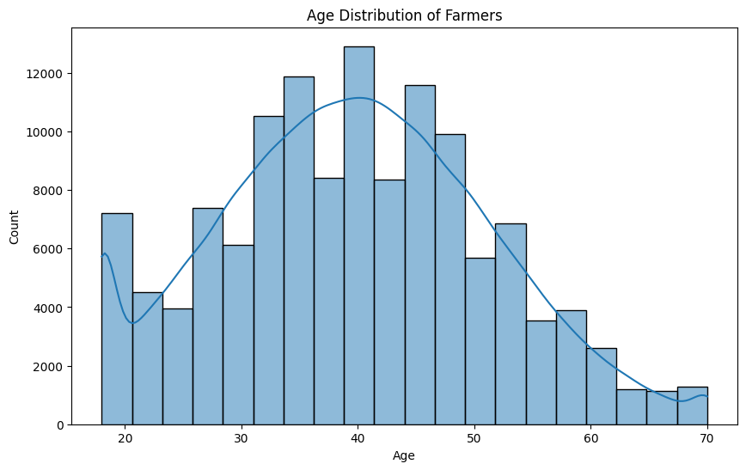
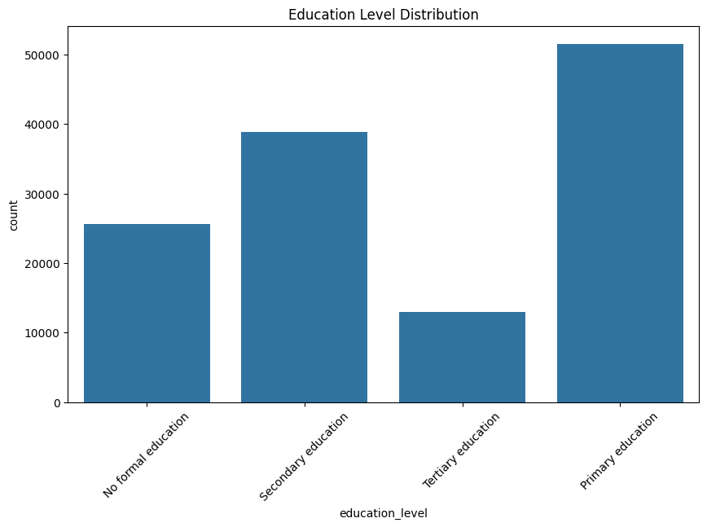
03
Data Insights
MISSION
The demographic analysis of smallholder farmers reveals important trends. The age distribution shows that most farmers are between 30 and 50 years old, indicating a skilled workforce but a concerning lack of younger farmers, which could impact agriculture's future. Education levels highlight that many farmers have only completed primary education, signaling a need for enhanced educational and financial literacy programs to improve credit utilization and productivity

Slide 6
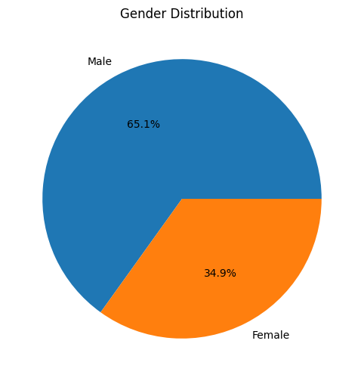
MISSION
The pie chart shows the gender distribution among farmers, indicating that 65.1% are male and 34.9% are female. This disparity emphasizes the importance of promoting gender inclusivity in agricultural credit programs, ensuring that both male and female farmers have equal access to financial resources and support. Together, these insights underscore the necessity of tailoring interventions to meet the diverse needs of the farming community.

Slide 7
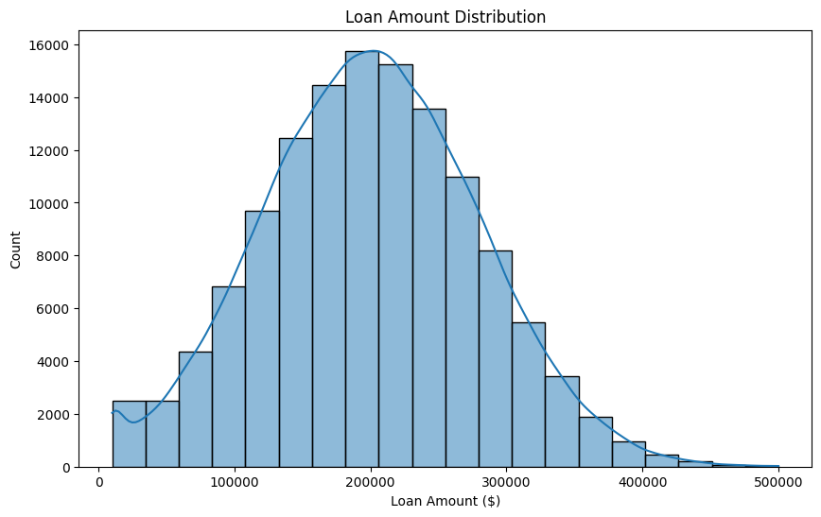
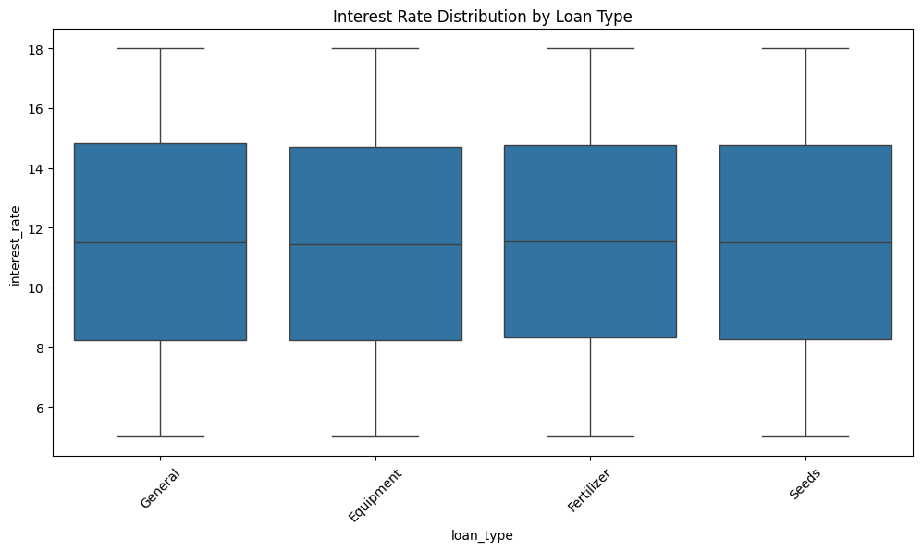
2.Loan Characteristics Insights
MISSION
The loan amount distribution shows that most loans are concentrated around $200,000, indicating that smallholder farmers typically seek moderate funding to meet their agricultural needs. The interest rate distribution by loan type reveals a consistent average of around 12% across general, equipment, fertilizer, and seed loans, suggesting that farmers face similar borrowing costs regardless of the loan purpose. Together, these insights highlight the borrowing patterns and financial conditions influencing access to credit for smallholder farmers.

Slide 8
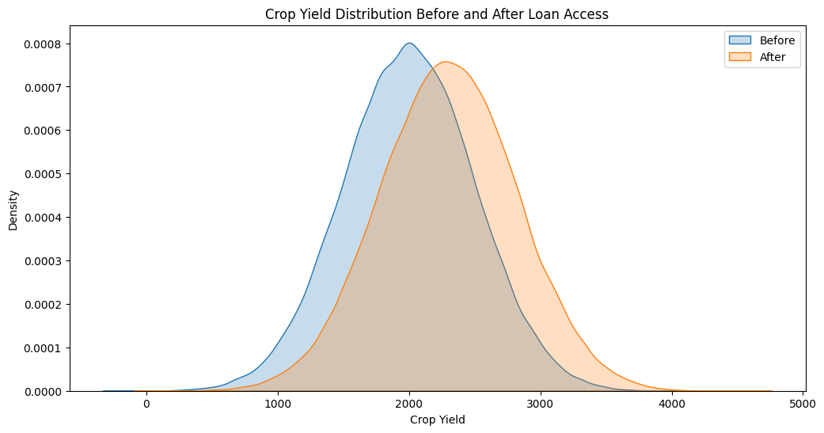
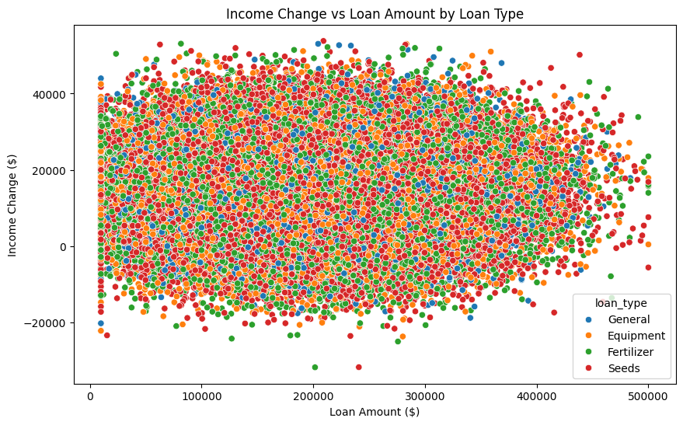
3.Productivity Metrics Insights
MISSION
The crop yield distribution chart illustrates a noticeable increase in yields after accessing loans, with the peak shifting from around 2,000 kg to higher values, indicating that loan access positively impacts agricultural productivity. Additionally, the income change versus loan amount chart demonstrates a diverse relationship between loan amounts and income changes across different loan types. While some farmers experience substantial income increases, others show minimal change, suggesting that factors beyond loan size, such as crop type and management practices, also play significant roles in determining agricultural success. Together, these insights emphasize the critical impact of loan access on productivity and income for smallholder farmers.

Slide 9
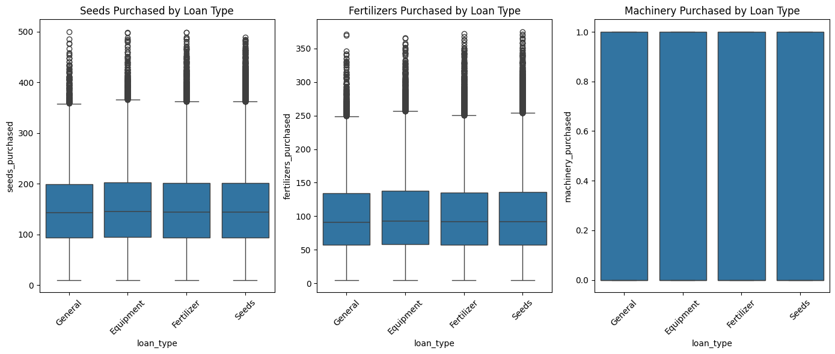
Agricultural Inputs Insights
04
MISSION
The charts reveal distinct patterns in the types of inputs acquired. Notably, fertilizer purchases show variations across loan types, indicating that farmers may allocate funds differently depending on their specific needs and the type of loan. In contrast, the seeds and machinery purchased appear more uniform across loan categories, suggesting consistent investment in these areas regardless of loan type. These insights highlight the strategic decisions farmers make when utilizing loans, emphasizing the importance of aligning loan offerings with the diverse input needs of smallholder farmers to optimize agricultural productivity.

Slide 10
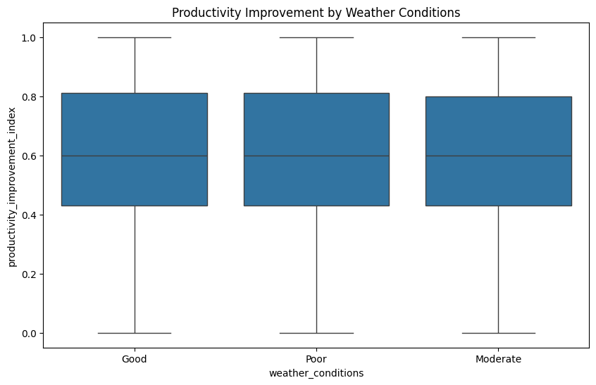
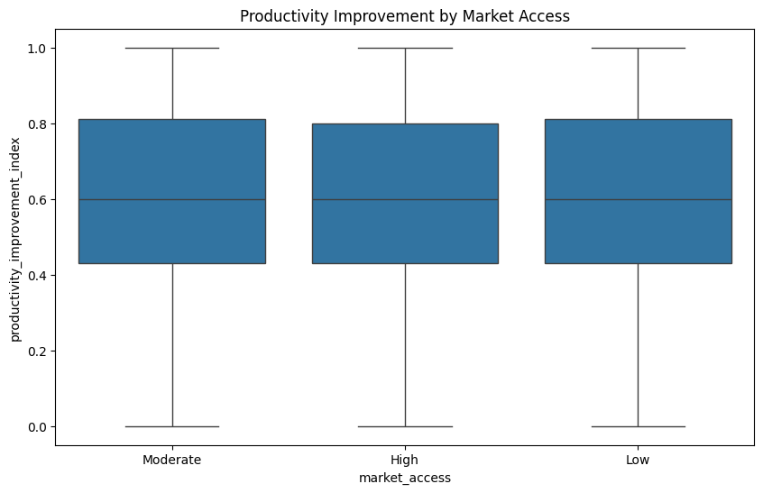
External Factor Analysis Insights
05
MISSION
The chart depicting productivity improvement by weather conditions shows that farmers experience similar levels of productivity enhancement across good, moderate, and poor weather conditions, indicating that other factors may mitigate the adverse effects of less favorable weather. Similarly, the analysis of productivity improvement by market access reveals consistent outcomes across low, moderate, and high market access levels. This suggests that while market access is crucial, its influence on productivity may be less pronounced than expected, highlighting the need for a multifaceted approach to enhance agricultural performance beyond just these external factors.

Slide 11
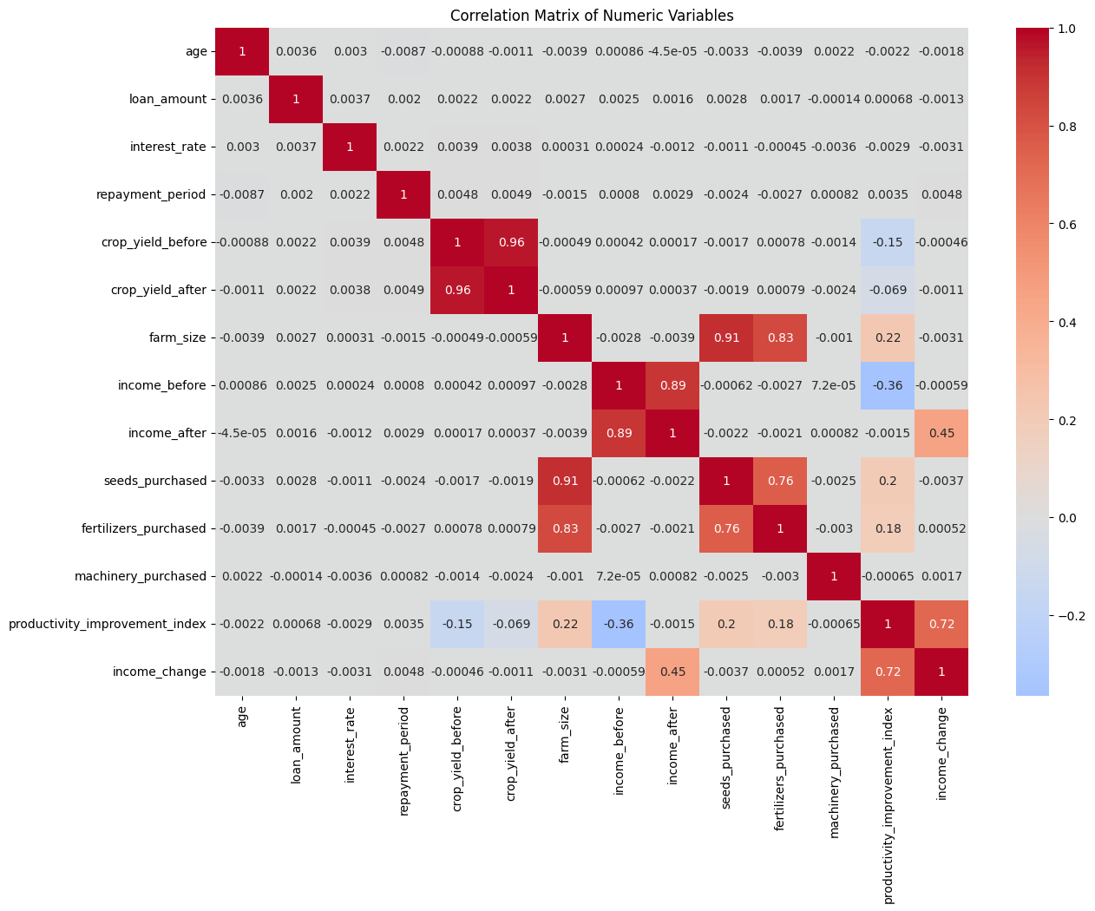
6.Correlation Insights
MISSION
A strong positive correlation (0.96) exists between crop yield after loan access and productivity improvement, indicating that effective loan utilization boosts productivity. Additionally, income change is notably related to crop yield and farm size, emphasizing their importance in driving income growth. In contrast, age and interest rate show minimal correlation with key outcomes, suggesting that other factors like crop management and input purchases are more impactful in enhancing agricultural success.

Slide 12

04
Recommendation
Short-term recommendations
Enhance Financial Literacy Programs: Implement workshops and training sessions for farmers to improve their understanding of credit options, loan management, and effective use of agricultural inputs.
Promote Gender Inclusivity: Develop targeted outreach programs to encourage female farmers to access credit and agricultural resources, ensuring equitable access to financial support.
Tailor Loan Products: Adjust loan products to better match the specific needs of farmers, such as offering smaller, more flexible loans for younger farmers or those with less experience.

Slide 13
04
Recommendation
Long-term recommendations
Implement Weather-Resilient Practices: Encourage the adoption of climate-smart agriculture practices to help farmers adapt to changing weather conditions, thereby improving resilience and productivity in the long run.
Strengthen Market Access: Work on improving infrastructure and supply chain logistics to enhance farmers' access to markets, enabling them to sell their products at better prices.

Slide 14

Implementation Plan
Short-Term Implementation Plan
Enhance Financial Literacy Programs
Timeline: 1-3 months
Resources Required: Training materials, facilitators, venues for workshops.
Key Stakeholders: Local agricultural extension officers, community leaders, NGOs.
2. Promote Gender Inclusivity
Timeline: 1-3 months
Resources Required: Outreach materials, promotional content, training resources.
Key Stakeholders: Women’s groups, local NGOs, community

Slide 15
3.Loan Products
Timeline: 4-6 months
Resources Required: Data from farmers, collaboration with financial institutions, marketing materials.
Key Stakeholders: Banks, microfinance institutions, farmer cooperatives.
Long Term Implementation Plan
Implement Weather-Resilient Practices
Timeline: 13-24 months
Resources Required: Training resources, climate-smart agriculture tools, monitoring systems.
Key Stakeholders: Agricultural experts, NGOs, local agricultural departments.
2.Strengthen Market Access
Timeline: 12-24 months
Resources Required: Infrastructure development plans, funding for logistics, community engagement strategies.
Key Stakeholders: Local government, transportation agencies, farmers' associations.

Slide 16
Predictive model building
Data Preparation
Standardized column names, managed outliers using the Z-score method.
Encoded categorical variables using One-Hot Encoding.
2. Feature Engineering:
Transformed skewed variables using logarithmic transformation to enhance model performance.
3.Model Selection:
Used multiple linear regression, random forest and XGBOOST for prediction.
4.Model Training & Validation:
Split the dataset into training and test sets using train_test_split.

Slide 17
Predictive model building
5. . Performance Evaluation
The predictive model was evaluated using the following metrics:
R-Squared (R²): Indicates the proportion of variance explained by the model.
Root Mean Squared Error (RMSE): Measures the average magnitude of prediction errors.
Mean Absolute Error (MAE): Assesses the average absolute difference between predicted and actual values

Slide 18
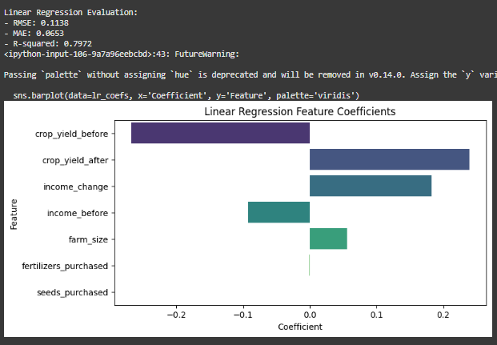
Multi Linear Regression, Random Forest and XGBOOST Models Performance

Slide 19
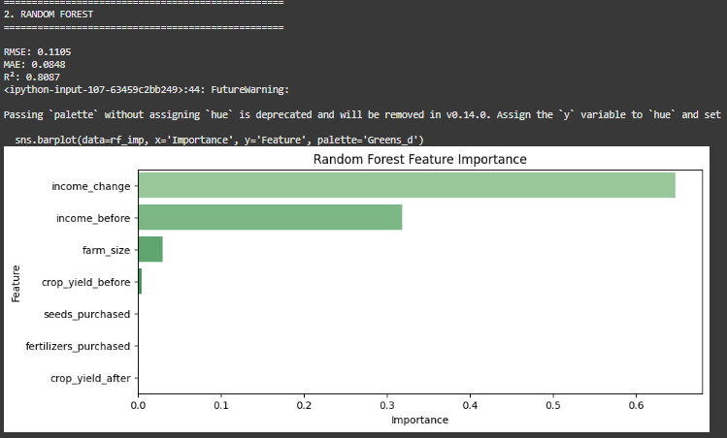
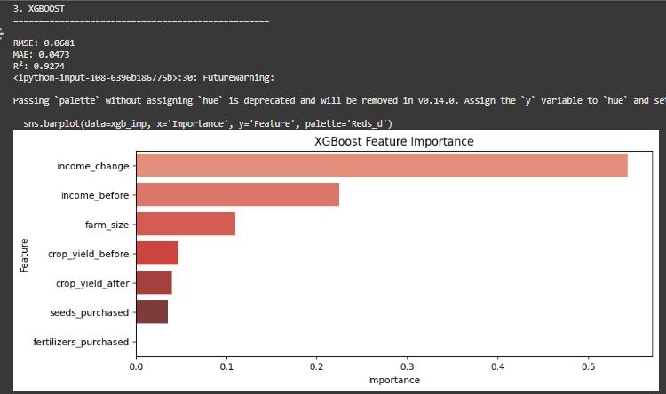
Random Forest

Slide 20
Model Selection for Deployment
Based on the performance evaluation metrics, the XGBoost model was selected for deployment, achieving the best results with an RMSE of 0.0681, MAE of 0.0473, and R² of 0.9274. These metrics indicate its strong predictive capability and high variance explanation. Although the Random Forest model and Linear Regression also demonstrated solid performance, XGBoost's superior metrics confirm it as the optimal choice for the project.

Slide 21
Important Independent Variables for Predicting Agricultural Outcomes
The analysis identified several key independent variables significantly influencing agricultural outcomes, selected based on their correlation coefficients such as Income change .These insights highlight the need for targeted interventions focusing on these critical areas to improve outcomes for farmers.
LIVE DEMO OF THE DEPLOYED APP: https://appuctivity-predictor-7sfuj3r6eyclvqshefzy2n.streamlit.app/

Slide 22
06
Conclusion
This project demonstrated the effective application of machine learning in predicting agricultural outcomes, with the XGBoost model selected for deployment due to its superior performance metrics, achieving an RMSE of 0.0681, MAE of 0.0473, and R² of 0.9274. Key independent variables, identified through correlation analysis, highlighted the critical roles of crop yield, farm size, and access to credit. These insights emphasize the importance of targeted interventions in resource allocation and market access to enhance agricultural productivity and support farmers in improving their outcomes.

Slide 23

DataVerse
Africa
Thank You
Internship Presentation

